Slide 1
Information Session and Public Hearing Draft Air Permit-to-Install and Operate
SOBE Thermal Energy Systems, LLC
Erik Bewley, Ohio EPA NEDO-DAPC
August 10, 2023
Eugenia Atkinson Recreation Center

Slide 2
Purpose for Tonight’s Meeting
Public Information Session
  Explain Ohio EPA’s air permitting process
  Overview of the draft Air Permit-to-Install and Operate (PTIO) issued to SOBE on July 6, 2023.
  Respond to questions related to the draft air PTIO
Public Hearing
  Gather public comments regarding the draft air PTIO

Slide 3
Air Permitting Milestones
September 12, 2022: Air Permit Application Received
March 31, 2023: Updated Air Permit Application Received
July 6, 2023: Draft Permit Issued

Slide 4
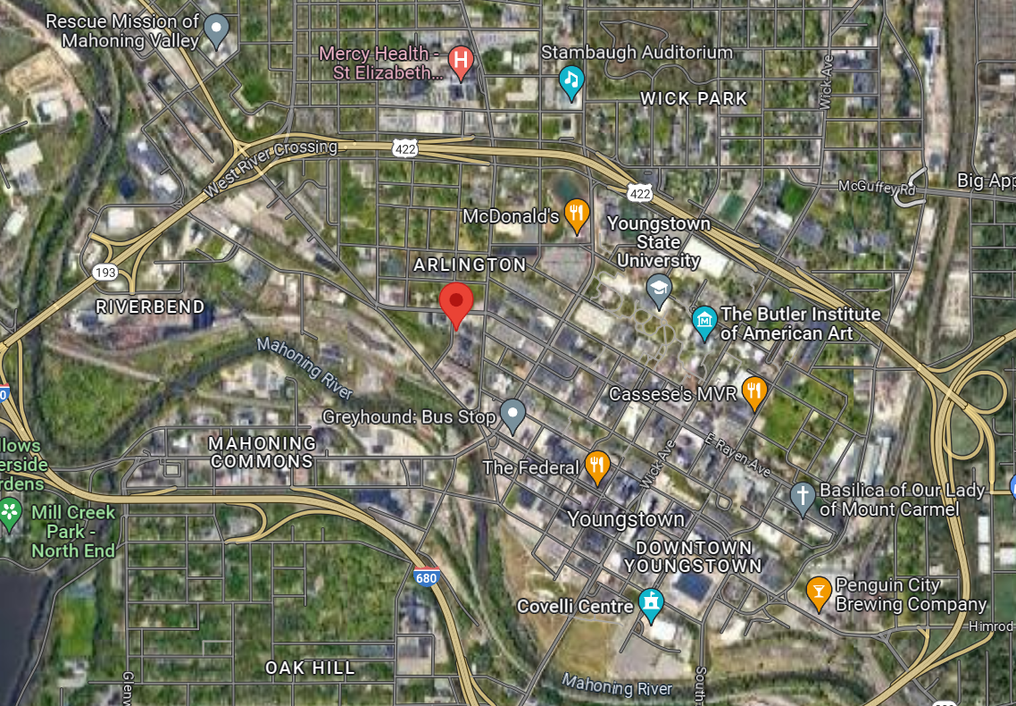
Proposed Location
205 North Ave, Youngstown, Ohio

Slide 5
Current Operations
SOBE supplies hot water/steam to customers by combusting only natural gas in a boiler and heating water.
Natural gas is supplied by pipeline from a separate facility.
Current Permitted Air Emissions Units
B005 – 31 MMBtu/hr natural gas-fired Boiler

Slide 6
Proposed Operations
Supply hot water/steam to customers by combusting natural gas and/or syngas in a boiler and heating water.
Natural gas is supplied by pipeline from a separate facility
Syngas will be produced on-site by Thermolyzer1 from Tire Derived Chips (TDC).

Slide 7
Draft PTIO P0132799
(Proposed Permit)
P001 – Thermolyzer1 (to produce syngas)
B006 – 55 MMBtu/hr Boiler (to combust natural gas and/or syngas)
B007 – 55 MMBtu/hr Boiler (to combust natural gas and/or syngas)

Slide 8
Thermolyzer1 Process (creating Syngas)
A form of gasification (driving off combustible gases) called pyrolysis (in very low oxygen atmosphere).
SOBE is proposing to use only TDC (88 tons per day) to produce syngas.
Gases will be cleaned before conveyance to the boilers or burners/flare
Liquids will be re-introduced into the Thermolyzer Process
Solids will be removed from the system.

Slide 9
Thermolyzer1 Term Highlights
- All emissions must go to Gas Cleaning Units (GCU) or flare.
All emissions from GCU must go to Boilers or Thermolyzer1 or flare
GCU monitoring:
- Pressure Drop (psig)
pH
Liquid flow rate (gpm)
Test for: PM, NO_{X}, CO, SO₂, VOC, HCl, and metals

Slide 10
Thermolyzer1 emissions
Natural Gas Pollutant Syngas
12.62 TPY NO_{X} 12.62 TPY
4.95 TPY CO 2.70 TPY
1.20 TPY PM 1.20 TPY
0.32 TPY VOC 0.22 TPY
0.05 TPY SO₂ 0.29 TPY
Visible emission limit: 20% opacity as a six-minute average
BAT Limit – applies to NO_{X} (0.21 lb/MMBtu)
Rule based limit – applies to PM (0.020 lb/MMBtu)

Slide 11
Boiler (Rated at 55 MMBtu/Hr)
Natural Gas Pollutant SynGas
7.58 TPY NO_{X} 16.86 TPY
9.64 TPY CO 9.64 TPY
4.82 TPY PM 4.82 TPY
1.31 TPY VOC 0.00 TPY
9.64 TPY SO₂ 9.64 TPY
Visible emission limit: 20% opacity as a six-minute average
BAT Limit – applies to NO_{X} (0.07 lb/MMBtu when on syngas)
Restriction – applies to CO (0.04 lb/MMBtu)
Restriction – applies to SO₂ (0.04 lb/MMBtu)
Rule Based Limit – applies to PM (0.020 lb/MMBtu)

Slide 12
Boilers Terms Highlights
- Only combust Natural Gas or Syngas from Thermolyzer1
Syngas is to be introduced into the flame zone
Minimum temperature restriction on boilers
Weekly syngas sampling and analysis
Testing for: PM, NO_{X}, CO, SO₂, VOC, HCl, and metals

Slide 13
Monitoring/Record Keeping and Reporting
Daily record amount of TDC processed and type of TDC processed
Daily VE checks
Daily track NG and syngas burned
Track boiler temperature
Report if VEs seen
Report if TDC mix is exceeded
Report if GCU parameters exceeded
Report if boiler temps drop

Slide 14
Compliance Monitoring
If the facility is installed, Ohio EPA will perform the following tasks to ensure the facility is in compliance.
Periodic inspections of the facility (announced and unannounced)
Review each report submitted
Witness emissions testing
Investigate citizen complaints

Slide 15
Citizen Complaints
If facility is installed and citizens have concerns:
Electronically report through (https://epa.ohio.gov/help-center/contact-us/submit-a-complaint)
Call the main line of the Northeast District Office
(330-963-1200)

Slide 16
Next Steps
Submit written Comments by Close of Business September 10, 2023.
email: DAPCNE.Comments@epa.ohio.gov
U.S. Mail: Ohio EPA NEDO-DAPC
attn: Erik Bewley
2110 E. Aurora Rd.
Twinsburg, OH 44087
Ohio EPA will review/consider all comments
Ohio EPA drafts Responsive Summary and makes decision regarding the draft air permit
Decision and Responsive Summary are distributed to Applicant and Interested Parties

